Slide 1
Warm Up: 3/2/2016
How much nitrogen is in the air around us?
78%

Slide 2
The nitrogen cycle

Slide 3
Objectives
Explain what the nitrogen cycle is with 80% accuracy utilizing the class materials and activity.

Slide 4
Nitrogen Cycle Simplified
http://youtu.be/ZaFVfHftzpl

Slide 6
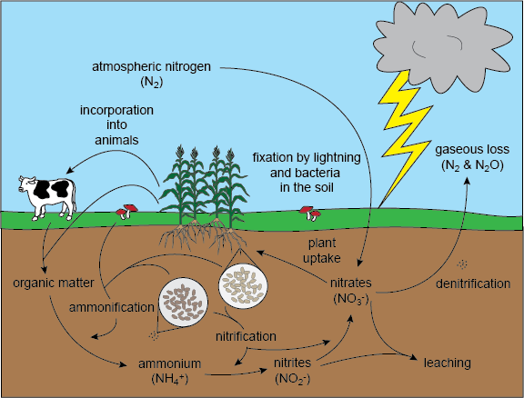

Slide 7
Plant and Bacteria Symbiosis
The bacteria that fix nitrogen in the soil have a symbiotic relationship
The plant’s root provide a place for the bacteria to live
The bacteria “fix” the nitrogen so the plant can use it

Slide 8
Review Points
Organisms use nitrogen less than carbon or water
Organisms cannot use atmospheric nitrogen directly. First it must be “fixed” by lightening or bacteria
A lack of nitrogen would eradicate life on Earth
The nitrogen cycle never ends; it keeps cycling

